Slide 1
Welcome to our Pearson Discover STEM Schools Roadshow 2018 Inspire a love of STEM in the classroom!
Mark Levesley

Slide 2
Exploring Science — The S in STEM
Image by Mark Levesley
Mark Levesley
Freelance
science education writer
November 2018
Exploring Science – The S in STEM
2
Notes:
My name is Mark Levesley and I am a freelance science education writer based in the UK. I wrote my first textbook in 1998

Slide 3
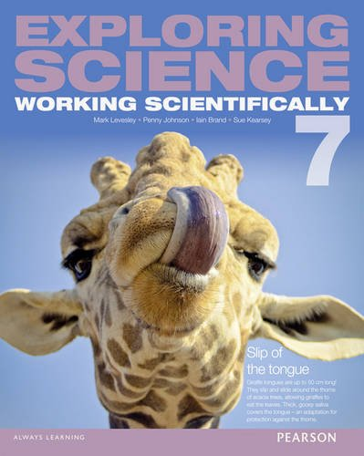
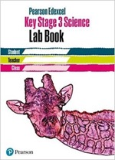
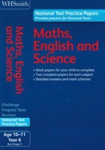
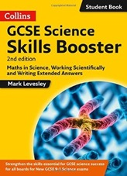
Introductions
Exploring Science – The S in STEM
Notes:
and have worked for most of the major UK publishers over the last 20 years, including Pearson. And here are some recent publications that I have worked on.
Apart from writing, I also act as series editor on many publications. One of my jobs as a series editor is to design how a course of books works. And that includes how the different subjects within science (biology, chemistry and physics) link together, and the links between science and other subjects, including the STEM subjects. And STEM is what I’m going to be talking about today.
In the course of this session, I’m going to show you some things, and share some ideas but I’m going to be asking you to do some work too. For that, everyone will need the photocopied pack that looks like this and something to write with. And at the end of the presentation, I will also give you details of where you can download the presentation.

Slide 4
What is STEM?
Science
Technology
Engineering
Maths
Exploring Science – The S in STEM
Notes:
Given that this is a STEM conference, I’m sure we all know what the STEM subjects are. Rather than subjects, some people like to call these the four pillars of STEM. Those subjects or pillars are:
[Click - science], [Click - technology], [Click – engineering], [Click – maths]. I did, however, meet someone last month who was convinced that the M stood for medicine. And that’s part of the problem with STEM education in that it seems to mean slightly different things to different people. So, I think it’s worth spending a few minutes asking ourselves:
• what we mean by STEM and why it contains four STEM subjects
• and what we mean by STEM education.

Slide 5
What is STEM education?
STEM education is …
a teaching methodology
that develops
a set of skills common to maths and science (and design & technology)
classes, to help students flourish in an increasingly technological society, and
to give students greater opportunities in the future workplace.
Exploring Science – The S in STEM
Notes:
Some people tell me that STEM education is about integrating the way that maths and science (and maybe design & technology) are taught in a school. [Click] So, for them it’s a teaching methodology. For others, STEM education is a set of skills that students develop while studying maths, science and design & technology. [Click] For others, STEM education is more aspirational, and is about pointing out to students the opportunities and career pathways that are open to those who work hard at science, maths and design & technology. It is a set of future opportunities. [Click]
And for some, offering STEM education just means that the school teaches science and maths. Others don’t want to put STEM education into their teaching of science because they think that it will mean that they have to completely change the way they teach science and start teaching technology and engineering as well, during science lessons. Some people will include various arts subjects within STEM education, arguing that careers in video games production or architecture, for example, require knowledge of art and artistic skills. So, some will talk about STEAM education.
Well, I’m not convinced by the argument that we need to include Art as well. There are links to be made between all the subjects that we teach in school and it’s always good teaching practice to highlight those links to students, and indeed to run joint activities with teachers of other subjects. But if we start adding too many subjects to STEM, we will lose focus. There is a reason why the four STEM subjects are put together, and we need to focus on that.
I think that STEM education is about equipping the next generation with the skills that they need to succeed in an increasingly technological society. So I think that STEM education is also a bit more than just teaching science and maths. But, I don’t think that STEM education is about re-inventing the school curriculum and introducing the teaching of engineering into science classes, for example.
For me, STEM education is a mixture of all those points currently on the screen. And [click] this would be my definition. [Read it out].

Slide 6
Are STEM subjects different?
Science
Technology
Engineering
Maths
We have a possible answer;
we need to work out if it’s correct.
We have an answer;
we need to work out how to use it.
We know the answer we want; we need to work out how to get there.
We think we may have an answer; we need to work out if we have an answer and what that answer is.
Exploring Science – The S in STEM
Notes:
In schools, we teach science and maths as standard, which is why many people assume that STEM education is just making sure that we teach those subjects well. Technology is taught in many schools (as design and technology) but certainly not all. And, if design & technology is taught, engineering is usually assumed to be part of that … but there are very few schools that teach engineering as a separate subject. So, why are there four subjects in STEM (and not just the ones we happen to already teach in a school).
The answer to that is that all four subjects, science, technology, engineering and maths have fundamentally different approaches and functions.
[Click] Science is about generating ideas (hypotheses) and testing them. We have an idea of why/how something happens, and then design a way of finding out if we are correct. We can say that in science: [Click] We have a possible answer; we need to work out if it’s correct.
[Click] Technology is about developing ways to use new discoveries. We have a new discovery, and then design novel ways of using it. We can say that in technology: [Click] We have an answer; we need to work out how to use it.
[Click] Engineering is about the process of reaching an answer or solution, rather than the solution itself. We have a plan for something that we want to build, and then design a process to make happen. We can say that in engineering: [Click] We know the answer we want; we need to work out how to get there.
[Click] Maths is about interrogating data to find out what is there. We have some data, and use mathematical ways of processing, probing and presenting that data to discover what it can show us. We can say that in maths: [Click] We think we may have an answer; we need to work out if we have an answer and what that answer is.
So, the four subjects have four fundamentally different approaches. And that’s why we have four STEM subjects.

Slide 7
Why do we put STEM subjects together? 1. Interrelationships
Scientific knowledge
Science
Technology
Engineering
Maths
Scientific processes
Exploring Science – The S in STEM
Notes:
So, if the four [Click, Click, Click, Click] STEM subjects are fundamentally different, why do we put them together in STEM? There are two reasons for this. The first is because they are very much interrelated.
We can think of science as being in two parts. [Click] There are scientific processes, which we use to make discoveries. And there are those discoveries that have been made using scientific processes – scientific knowledge. When we teach science, we teach both of these aspects. We teach students what we know and how we’ve found those things out.
And that scientific knowledge inputs into the development of new Technology, new Engineering and new Maths. [Click for circles].
For example, a greater knowledge of the nature of light has led to advances in laser technology, something for which Donna Strickland won a Nobel prize a few weeks ago. [Click for Donna]
Or an increase in the knowledge of bonding in materials leads to new materials being engineered, such as Kevlar invented by Stephanie Kwolek. [Click for Stephanie]
Or an increase in the knowledge of electrical circuits leads to new maths, such as Alan Turing’s early computer language. [Click for Alan]
And all of these feed back into science. The lasers are used to discover more about molecules, the discoveries about Kevlar leads to more discoveries about polymers, the computer language is used to perform calculations more quickly. And so those feedback loops go on and on. The four subjects do not evolve in isolation from one another.

Slide 8
Why do we put STEM subjects together? 2. The seven STEM skills
 | Apply knowledge to unfamiliar contexts to reach answers.
 | Combine ideas to reach answers.
 | Use reasoning and systematic approaches to reach answers.
 | Design ways of collecting and analysing data to reach answers.
 | Give reasons why data (or proposed solutions) are or are not good enough (e.g. to answer questions, solve problems).
 | Use maths.
 | Use language and maths to communicate ideas effectively.
Application of knowledge
Innovation and invention
Problem-solving
Generation and analysis of data
Critical evaluation
Use of maths
Communication
Exploring Science – The S in STEM
Notes:
The second reason that we put those four subjects together as STEM is because those subjects make use of a common set of skills. And I think that there are seven of these core STEM skills which I shall briefly go through.
[Click down table]
The ability to …
Looking at these skills, we are all aware that there are many different aspects of each one. For example, there are thousands of different ways in which you can do maths.
Think of each skill as being a toolbox, and as students develop a STEM skill, they are adding more tools to that particular toolbox. And so, when a student is faced with a situation that demands problem-solving (for example), a student with more tools in his or her ‘problem-solving toolbox’ is better equipped to solving a broad range of problems and so more likely to solve any given problem. And having a broader range of tools to use for a skill, also makes it more likely that students will find the tools that best suit their own ways of working.

Slide 9
How do we implement STEM education?
STEM education is …
a teaching methodology
that develops
a set of skills common to maths and science (and design & technology)
classes, to help students flourish in an increasingly technological society, and
to give students greater opportunities in the future workplace.
Exploring Science – The S in STEM
Notes:
This was the slide I used earlier to show what I think STEM education is about.
In terms of teaching methodology, some people tell me that in order to deliver STEM education you have to have special 'STEM lessons’, to do a piece of work that clearly links two or more STEM subjects together. And that is a good idea but if that is the only way in which STEM education is done, students can see STEM as a separate subject. So, we also need to have STEM education integrated into everyday teaching of science.
For me, there are three simple ideas that we can all use in order to achieve this.
First, I’m going to suggest that the science department in your school sits down with the maths department (and the Design & Technology department, if you have one). Teachers in all those departments need to agree a common language to use when talking about STEM. I’ve given you what I think are the seven core STEM skills and some words of explanation. But you and your colleagues may come up with slightly different wordings. Sitting down and discussing the wording is a good idea, to make sure that all teachers are able to agree a common approach to STEM education and agree a common set of skills, which everyone understands. If teachers of maths, science and design & technology can highlight STEM skills as they are met during their teaching, use the same set of STEM skills and call them by the same names, students will better understand the links between the different subjects and how skills learnt in one subject can be applied to another.
In terms of students developing the set of skills (the second point in blue here), this is what you are going to look at in a minute: some activity ideas, focussed on science but involving STEM skills. The general idea is to think about making some of the activities you already do, more active and more exploratory, and less guided. So that students have to find out more for themselves, rather than just being fed information.
And for the last point in blue, think about the examples and contexts you use in your teaching. Use technological, engineering and mathematical examples where you can, and highlight to students how STEM skills are used in a variety of contexts, both in terms of everyday modern life and in terms of possible careers and opportunities that are open to people with well-developed sets of STEM skills.

Slide 10
How do we implement STEM education?
Agree and use common language about STEM skills in science and maths (and design & technology).
Introduce more exploratory classroom activities, which involve STEM skills.
Use examples with clear links to STEM (including careers).
Application of knowledge
Innovation and invention
Problem-solving
Generation and analysis of data
Critical evaluation
Use of maths
Communication
Exploring Science – The S in STEM
Notes:
So, in summary, our simple ways of introducing a greater element of STEM education into the everyday teaching of science are:
[Green table]
And this are what I think are the seven key STEM skills.
[Click for blue table of skills]
So, moving to the second of my points in green here … let’s look at some activity ideas for integrating STEM into everyday teaching.
We’re first going to look at an activity to develop communication skills.

Slide 11
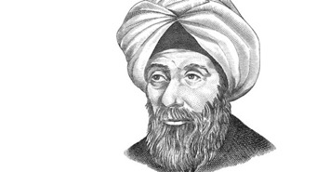
What are some STEM activities? 1. Communication
Exploring Science – The S in STEM
Notes:
And it’s now time for you to do some work. In the photocopies that you should have in front of you, you’ll find a sheet that looks like this. We’re going to do a brief activity on the Scientific Method, that great foundation of modern science that was developed by Hasan Ibn al-Haytham [Click] in the Golden Age of Arabic Science. What I want you to do is to construct a diagram to show the scientific method. I’d like you to work in groups of two or three or four. And don’t worry about being neat or worry to much about what you think I’m expecting. There is no one correct answer. This is about being ‘exploratory’ in your thinking.
[5 mins]
OK. [General discussion on who has used arrows as a flow chart, or a timeline or a life cycle or numbered sequence or lettered sequence] There are different ways of showing this information but in all those different ways we’ve communicated a sequence, using arrows or numbers or letters to show an order in a simple to understand fashion.
And of course, in your group discussions about how best to draw this diagram you have also been communicating with one another.
Communicating information in a clear and concise way is a key STEM skill. By sharing and discussing different approaches in groups, students often teach one another different tools [Click] for communication. As a teacher, you would then share your own approach with the students, which may further increase the tools that they add to their communication toolboxes [Click].
In this diagram-making activity I asked you to use certain labels, words or phrases and construct a diagram,
But you could give students a diagram, without any labels, and ask them to label it to explain something.
Or get students to produce diagrams that communicate information given to them in a paragraph (for example, one from a text book).
Or ask them to think about a concept that they have just learnt about and explain it in a diagram using as few words as possible.
So, consider using more diagram-making activities in order to develop communication skills.
Students will get a lot out of a diagram-making activity if:
a) it is more exploratory (and students have to work together and think for themselves)
b) they know that the activity is also about developing a key STEM skill – communication, and not just science.
And this type of activity also often helps students to remember the information they are supposed to be learning.

Slide 12
What are some STEM activities? 1. Communication
Observation
Communication
Question
Application of knowledge
Use of maths
Problem-solving
Hypothesis
Innovation and invention
Prediction
Investigation
Generation and analysis of data
Data
Does the data match the prediction?
Critical evaluation
Hypothesis supported
Exploring Science – The S in STEM
Notes:
So, this is my diagram of the scientific method. It’s not necessarily the best one but in coming up with a diagram, we develop communication skills [Click], but in this example we’ve also used sequencing of numbers or a flow chart or a table which involves use of maths [Click for maths].
In terms of the scientific method, my answer is this. [Click for filled-in chart] However, as we shall see in a minute, not all science is done strictly according to these steps, and all that we really mean by the scientific method is a process in which we generate a hypothesis that can be tested.
The whole process of the scientific method is about how scientists solve problems [Click for problem solving].
And equally as we meet other steps in the process, we can highlight for students other STEM skills that are being used and developed, such as application of knowledge, and innovation and invention [Click for hypothesis] when it comes to constructing hypotheses.
And our investigations are about the generation [Click for Investigation] and analysis of data, and of course [Click for critical evaluation] some critical evaluation has to go on too. And the more you think about this the more places you could highlight STEM skills within the scientific method. So, we already teach STEM skills in science …

Slide 13
How do we implement STEM education?
Agree and use common language about STEM skills in science and maths (and design & technology).
Introduce more exploratory classroom activities, which involve STEM skills.
Use examples with clear links to STEM (including careers).
Application of knowledge
Innovation and invention
Problem-solving
Generation and analysis of data
Critical evaluation
Use of maths
Communication
Exploring Science – The S in STEM
Notes:
… but we need to point them out and highlight them for students, and we need to use STEM skills language that teachers of maths and design and technology also use.
And diagram-making activities, like the one you have just done, [Click for second point] are just one way of introducing more exploratory activities into your everyday science teaching, which help to develop STEM skills.
Let’s look at another STEM skill: generation and analysis of data.

Slide 14
What are some STEM activities? 2. Generation and analysis of data
Observation
Question
Hypothesis
Prediction
Investigation
Data
Does the data match the prediction?
Hypothesis supported
Exploring Science – The S in STEM
Notes:
Many scientists use investigations [Click for reveal] much like the ones we use in school, where we change an independent variable and measure the changes in a dependent variable. If students are asked to design an investigation, they have a very narrow idea of how to design it to generate and analyse data – they often think that the right answer has to involve physical variables that they can change, or measure or control. Their ‘generate and analyse data’ toolbox is not very full. [Click for toolbox]

Slide 15
What are some STEM activities? 2. Generation and analysis of data
Exploring Science – The S in STEM
Notes:
For example, we might tell students that adding a metal to some copper sulfate solution will cause an increase in its temperature. [Click for image.] A scientific question from this observation might be ‘Do different metals cause different increases in the temperature’. A simple hypothesis then becomes ‘The temperature increase depends on the type of metal added’. We might predict ‘If I add some different metals to copper sulfate solution, then I will see different increases in temperature.’ Our independent variable is the one we change (the type of metal) and the dependent variable is the one that we measure (the temperature increase). We will then also control some variables (like the form of the metal, the starting temperature of the copper sulfate solution, the concentration of the copper sulfate solution, the mass of the metal etc. etc.). And we do our investigation. [Click for animation.]
This is all perfectly good science but many students think that all scientific investigations are done in the same way, in which one real, physical variable is measured as another real, physical variable is changed. But if students are challenged to think a bit deeper, they will realise that this cannot possibly be true. In medicine, for example, you can’t do experiments on deadly human diseases using humans because it is unethical.

Slide 16
What are some STEM activities? 2. Generation and analysis of data
Exploring Science – The S in STEM
Notes:
In paleontology, you can’t do experiments on the organisms because most of them have been extinct for a long time.

Slide 17
What are some STEM activities? 2. Generation and analysis of data
Exploring Science – The S in STEM
Notes:
In astronomy, you can’t remove a black hole to see how the lack of its gravitational pull now affects a galaxy.
Scientists working in these fields need to use non-experimental forms of hypothesis testing. In a non-experimental hypothesis test, a scientist predicts observations (or patterns) that should be able to be found if the hypothesis is correct but they have no control over the variables. The scientist then collects and analyses data, seeing whether the there have been any changes in a certain variable and whether those changes have produced the patterns predicted.

Slide 18
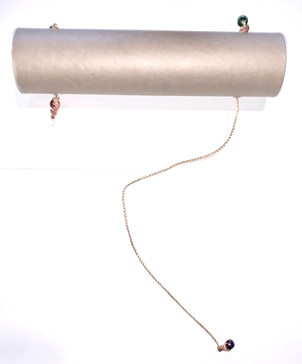
What are some STEM activities? 2. Generation and analysis of data
Your mission:
To come up with a hypothesis for what is inside your mystery tube and how the strings are connected.
Rules:
1 – You may not open the tube.
2 – You may not damage the tube.
Exploring Science – The S in STEM
Notes:
Non-experimental hypothesis testing, like this, takes a long time. So some scientists try to transfer their hypothesis onto something else, something that will allow them to alter and measure variables.
[Click for mystery tube] This is a mystery tube. I’ve got one here. It contains four strings, which move in and out of the tube when I pull them [demonstrate]. I’m handing around some mystery tubes now. I’d like you to work in groups of two or three and examine the mystery tube that you are given. You are going to try to work out what is in the mystery tube and how the strings are connected. But there are some rules: [Click for rules]
You may not open the tube.
You may not damage the tube in any way.
I will also say that not all of the mystery tubes are the same.
I’m going to give you a few minutes to come up with some ideas.
OK, times up. Let’s hear some of your hypotheses. [Call out for some ideas.]
Great. There are some excellent hypotheses out there. What can we do now to check if our hypotheses are correct?
[Feedback] Yes, we can make a model.

Slide 19
What are some STEM activities? 2. Generation and analysis of data
Your mission:
To build a model that can explain how your mystery tube works.
Rules:
1 – You may not open the tube.
2 – You may not damage the tube.
Exploring Science – The S in STEM
Notes:
And I happen to have some equipment for you to use in these bags. So, I’m going to give you a few minutes to make a model to behave in the same way that your mystery tube does. You won’t need all the equipment in each bag. And your model won’t look exactly like the mystery tube (for example, there are no end caps and there is no real need to use the coloured beads … they are just there on the mystery tubes to stop the strings disappearing through the holes).
[5 - 10 minutes]
Some of you have now got models that explain the behaviour of the mystery tubes.
While building the models, we’ve used a process of trial and error where we have constructed a model and then made predictions and then tested those predictions. When the predictions didn’t match the behaviour of the mystery tube then we went back and altered the model. In doing this we’ve generated and analysed data, we’ve also made observations which we have used to innovate and invent new versions of our model.
So, when faced with doing non-experimental forms of hypothesis testing, scientists often use models to allow them to make changes to independent variables and measure dependent variables.

Slide 20
What are some STEM activities? 2. Generation and analysis of data
From Exploring Science: Working Scientifically Student Book 7
Exploring Science – The S in STEM
Notes:
An example, is the particle model of matter, which was constructed by scientists a long time before it ever became possible to investigate or see atoms and molecules. The model fitted all the evidence that those earlier scientists had, and having worked it out they also used it to make predictions.
Einstein’s mathematical model of gravity fits all the observations and has been used to make predictions, such as gravitational waves. However, we still don’t know what gravity is … we still can’t look inside the ‘gravity mystery tube’. We just have to use our model.

Slide 21
What are some STEM activities? 2. Generation and analysis of data
From Exploring Science:
Working Scientifically Activity Pack 7
Exploring Science – The S in STEM
Notes:
Faced with non-experimental hypothesis testing, some scientists can’t construct neat physical or mathematical models that allow them to change an independent variable and then measure a dependent variable. But they can develop models in which they predict the outcome of changes to a variable, and then look through data to try to find examples of where that variable has changed and whether the predictions are correct.
This is what astronomers and paleontologists do. And ecologists use food web models to make predictions of what happens if the population of one organism in a habitat changes. In your photocopy packs, there’s a copy of this sheet [Click] which is about building a food web model.
We use a lot of models in our teaching of science anyway; we just need to highlight some of the STEM skills that are being developed as we use and develop them. And in this case, we need to make sure that students understand why scientists use models to generate and analyse data.
In terms of the other STEM subjects, a lot of maths is about constructing abstract mathematical models.
Engineers use physical models to work out how to achieve something.
And models are used in the technology that we use everyday, for forecasting the weather for example or artificial intelligence.

Slide 22
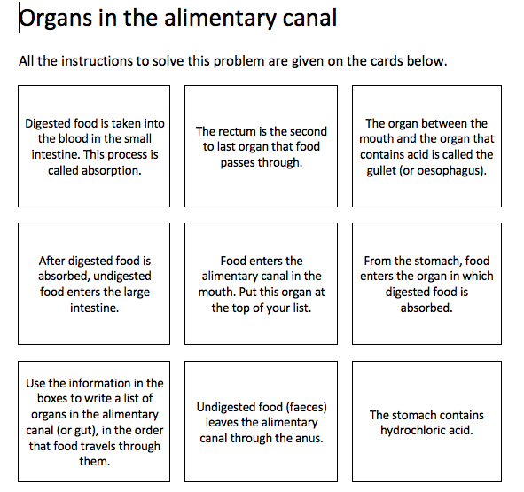
What are some STEM activities? 3. Problem-solving
Exploring Science – The S in STEM
Notes:
Let’s look at another STEM skill. Problem-solving. And here’s an another exploratory activity that can be used to develop a STEM skill, and teach some science.
In your photocopy packs, you should have something that looks like this: Organs of the alimentary canal. And I’d like you to have a go at doing that activity now. Feel free to work in small groups as you were doing.
[Pause for completion of activity]
You’ll see that you didn’t actually need to know anything about the alimentary canal in order to complete this activity. So, you can make up a problem-solving activity like this at the start of teaching students about something, so that they are learning what they need to learn, but in a different way … a way that is developing a STEM skill (which you can also point out to them). It’s developing the tool of how to put information in logical order. For some students it will help them develop that tool if they can cut out the cards.
And these types of problem-solving puzzles can be used after students have learnt about something as well. And in your photocopied packs there are three examples of this for you to try. Each one generates a slightly different way of displaying some information.

Slide 23
How do we implement STEM education?
Agree and use common language about STEM skills in science and maths (and design & technology).
Introduce more exploratory classroom activities, which involve STEM skills.
Use examples with clear links to STEM (including careers).
Application of knowledge
Innovation and invention
Problem-solving
Generation and analysis of data
Critical evaluation
Use of maths
Communication
Exploring Science – The S in STEM
Notes:
There are plenty of activity ideas that you can use to introduce other STEM skills into your science teaching, but I would urge you to choose activities that deliver both the science and the STEM skills. At the end of your handouts I have listed some useful websites for this.
Where you can, I would urge you to use examples and contexts with clear links to other STEM subjects, and to STEM careers. This will allow students to start to understand why they are developing STEM skills and why they are so important.
So, if you’re writing questions or making worksheets or designing a presentation for use by students, put in some STEM examples (such as STEM-oriented jobs).
You may be using text books in your teaching, and it’s worthwhile highlighting STEM examples in those books, including the jobs people are doing. So, I’m just going to give you some examples from one of my courses, which some of you may be familiar with: Exploring Science.
https://undsci.berkeley.edu/
https://www.stem.org.uk/
https://practicalaction.org/schools

Slide 24
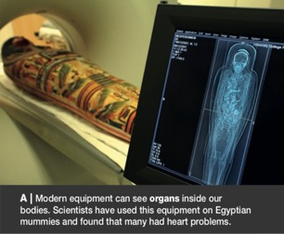
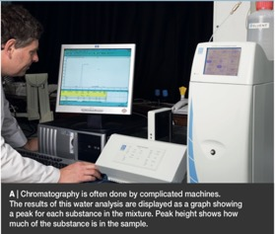
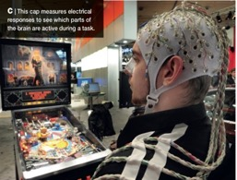
How do we implement STEM education?
Exploring Science – The S in STEM
Notes:
Exploring Science is designed for lower secondary, and contains many links to STEM. Here are some examples of careers and opportunities: we have a paramedic, a bit about archaeology, a water scientist, the development of games and even how some people have used scientific ideas to create music.

Slide 25
How do we implement STEM education?
Exploring Science – The S in STEM
Notes:
Various pages in the books are devoted to exploring the links between science and technology, and between science and engineering. And equally there are pages that explore the links between science and maths.

Slide 26
How do we implement STEM education?
Exploring Science – The S in STEM
Notes:
There are also pages that develop certain STEM skills. This one is obviously all about the use of maths.

Slide 27
How do we implement STEM education?
Exploring Science – The S in STEM
Notes:
And this one is about effective communication.

Slide 28
How do we implement STEM education?
STEM education is …
a teaching methodology
that develops
a set of skills common to maths and science (and design & technology)
classes, to help students flourish in an increasingly technological society, and
to give students greater opportunities in the future workplace.
Exploring Science – The S in STEM
Notes:
That brings me to the end of what I wanted to share with you. In summary, I hope that I have given you some things to think about in terms of what STEM education is, its importance and how it can be integrated reasonably easily into your existing teaching of science.

Slide 29
How do we implement STEM education?
Agree and use common language about STEM skills in science and maths (and design & technology).
Introduce more exploratory classroom activities, which involve STEM skills.
Use examples with clear links to STEM (including careers).
Application of knowledge
Innovation and invention
Problem-solving
Generation and analysis of data
Critical evaluation
Use of maths
Communication
Exploring Science – The S in STEM
Notes:
For me, there are three key things that need to be done in order to incorporate STEM effectively into the teaching of science. [Click] And in doing this we should be able to develop not only an appreciation of the importance of STEM in the students that we teach, but also help them to develop the seven [Click] core STEM skills that will enable them to flourish in an increasingly technological society.

Slide 30
Further information
Instructions for mystery tubes at:
https://undsci.berkeley.edu/lessons/mystery_tubes.html
Useful websites for finding STEM skill activities:
https://undsci.berkeley.edu/
https://www.stem.org.uk/
https://practicalaction.org/schools
@marklevesley
www.levesley.com
Exploring Science – The S in STEM
Notes:
Here are a few websites that I think you might find useful, and some ways to stay in touch with me. All this information is also at the bottom of your handouts.
Very many thanks for working so hard! And I hope to see you later in the round table discussion at the end of the day.

Slide 31
International Schools Community
Join our STEM International Schools Community Group to access…
Information about STEM Professional Development events from Pearson in the region (face-to-face and online).
The latest thinking in STEM education from industry experts delivered through articles, blogs and webinars.
The sharing of best practice in STEM education from UK and US curriculum teachers (K-12).
The sharing of experiences from other group members and the opportunity to network with other STEM educators.
https://community.pearsoninternationalschools.com/
clubs/view/pearson-discover-stem-middle-east

Slide 32
There’s so much more to learn
Find out more about us at
middleeast.pearson.com

